Slide 1
Organizing Organizing principles. Organizational structures.
Lecture
5

Slide 2
Questions
What is organizing as a function of management?
What are the main principles of organizing and how are they described?
How is organizational hierarchy understood?
How are mechanistic and organic organizations described?
What is organizational structure and why is it needed?
What are the types of organizational structure?

Slide 3
What is organizing?
Organizing
Organizing can be thought of as assigning the tasks developed under the planning function to various individuals or groups within the organization.
Organizing creates a mechanism to put plans into action.
Organizing includes determining tasks and groupings of work.
Organizing should not be rigid, but adaptable and flexible to meet challenges as circumstances change.
Notes:
Organizing is a management function that involves arranging people, resources, and tasks in a coordinated and systematic way to achieve the goals of an organization. It involves identifying the activities to be performed, grouping them into departments or teams, delegating responsibility and authority, and establishing relationships among individuals and groups to facilitate communication, coordination, and cooperation.
The organizing function is important because it enables an organization to operate efficiently and effectively, with clear lines of authority, responsibility, and communication. Effective organizing ensures that tasks are completed in a timely and cost-effective manner, that resources are used efficiently, and that employees are empowered to make decisions and take ownership of their work.
Organizing can include creating organizational charts, establishing job descriptions and roles, developing communication channels, setting up workflows and processes, and implementing systems and tools to support coordination and collaboration. It is an ongoing process that requires ongoing evaluation and adjustment to meet changing needs and goals.
Work specialization is a key component of organizing. It involves dividing work into smaller, more specialized tasks that can be performed by individuals or groups with specific skills or expertise. Work specialization is also known as division of labor.
The idea behind work specialization is that by breaking down complex tasks into smaller, more manageable parts, individuals can become more efficient and productive in their work. This leads to greater output and improved quality of work. For example, in a manufacturing plant, work specialization might involve dividing the production process into separate tasks such as assembly, painting, and quality control, each performed by a specialized worker or team.

Slide 4
Organizing is a management function that involves the systematic arrangement of people, resources, and tasks to achieve the goals of an organization.
Notes:
Arranging things in a systematic way means that there is a clear and organized method or structure to how things are done. In the context of organizing as a management function, this means that individuals, resources, and tasks are arranged in a structured and coherent way to achieve the goals of the organization.
This systematic arrangement can involve a variety of factors, such as establishing clear lines of authority and responsibility, grouping tasks into departments or teams, developing communication channels and workflows, and implementing systems and tools to support coordination and collaboration. The purpose of arranging things in a systematic way is to ensure that everyone within the organization understands their role, knows who they report to, and has a clear understanding of how they contribute to achieving organizational goals.
By arranging things in a systemic way, managers can minimize confusion and uncertainty, reduce duplication of effort, and improve overall efficiency and effectiveness. It also helps to establish a clear and coherent organizational culture, which can contribute to employee motivation and job satisfaction.

Slide 5
The organizing process cycle
Identify the tasks to be performed
Group tasks into jobs or departments
Assign tasks to individuals or teams
Delegate authority and responsibility
Establish relationships and communication channels
Evaluate and adjust the organizing process
Notes:
The organizing process cycle refers to the series of steps that managers typically follow in order to organize an organization. While there may be some variation in the specific steps involved, the organizing process cycle typically includes the following steps:
Identify the tasks to be performed: This involves breaking down the overall goals of the organization into specific tasks or activities that need to be completed in order to achieve those goals.
Group tasks into jobs or departments: Once the tasks have been identified, they are grouped together based on similarities in function or skill set. This can involve creating departments or teams within the organization.
Assign tasks to individuals or teams: Once the tasks have been grouped, they are assigned to individuals or teams based on their skills, expertise, and availability.
Delegate authority and responsibility: In order for individuals or teams to be effective in completing their tasks, they must be given the appropriate level of authority and responsibility to make decisions and take action as needed.
Establish relationships and communication channels: Effective communication is essential for coordination and cooperation within an organization. Managers must establish clear lines of communication and relationships among individuals and groups to ensure that tasks are completed efficiently and effectively.
Evaluate and adjust the organizing process: Finally, managers must continually evaluate the effectiveness of the organizing process and make adjustments as needed to ensure that it continues to meet the changing needs and goals of the organization.
By following this organizing process cycle, managers can create a well-structured and efficient organization that is able to achieve its goals effectively.

Slide 6
Main organizing principles

Slide 7
Main organizing principles
Specialization
Coordination
Departmentalization
Chain of command
Span of control
Centralization and decentralization
Formalization
Notes:
Organizing principles are necessary for creating an efficient and effective organizational structure that can achieve the goals of the organization. Understanding these principles is essential for managers who want to design an effective organizational structure that can adapt to changing circumstances and achieve long-term success.
There are several reasons why organizing principles are necessary. First, they provide a framework for structuring an organization that is efficient, effective, and capable of achieving its goals. Without a clear understanding of these principles, managers may struggle to create a well-structured organization that can operate efficiently.
Second, organizing principles help managers to identify the most appropriate organizational structure for their organization. By understanding the benefits and drawbacks of different principles, managers can choose the approach that is best suited to their organization's goals, resources, and culture.
Third, organizing principles can help managers to identify potential problems and inefficiencies within their organization. By evaluating their organization against these principles, managers can identify areas where improvements can be made and implement changes to improve efficiency and effectiveness.
To apply organizing principles effectively, managers must understand the specific principles and how they can be applied to their organization. This involves a process of evaluating the organization's goals, resources, and culture, and identifying the organizing principles that are most appropriate for achieving those goals.
Once the appropriate organizing principles have been identified, managers can apply them by designing an organizational structure that incorporates these principles. This may involve creating departments or teams, delegating authority and responsibility, establishing communication channels, and developing policies and procedures that align with the chosen organizing principles.

Slide 8
What is specialization?
Specialization or division of labor
the process of breaking down work into smaller, more specialized tasks that can be performed by individuals or groups with specific skills or experience.
Advantages | Disadvantages
Increased efficiency Better quality Lower costs Increased job satisfaction, if skills can be utilized | Boredom and dissatisfaction, if the job is too specialized and routine Limited skills development Coordination challenges
Notes:
Specialization, also known as division of labor, is the process of breaking down work into smaller, more specialized tasks that can be performed by individuals or groups with specific skills or experience. Specialization is a key principle of organizing and can have several advantages and disadvantages.
Advantages of specialization include:
Increased efficiency: By breaking down complex tasks into smaller, more manageable parts, individuals can become more efficient and productive.
Better quality: By focusing on a smaller set of tasks, individuals can become highly skilled and experienced in performing them, resulting in better quality work.
Lower costs: Specialization can reduce costs by saving time and resources needed to complete tasks.
Increased job satisfaction: When individuals can focus on tasks that match their skills and interests, they can feel more satisfied with their work.
Disadvantages of specialization include:
Boredom and dissatisfaction: If work is too specialized, employees may become bored or dissatisfied with their work, leading to lower productivity, higher turnover, and reduced job satisfaction.
Limited skill development: Specialization may limit the development of broader skills and knowledge that may be needed to adapt to changes in the work environment.
Coordination challenges: Coordinating and integrating the work of specialized individuals or teams may be difficult, leading to delays, errors, or communication breakdowns.
An example of elementary specialization can be seen in an automobile manufacturing plant. The production process can be divided into separate tasks such as assembly, painting, and quality control, each of which is performed by a specialized worker or team. While this approach can increase efficiency and quality, it can also lead to employee boredom and dissatisfaction, as well as coordination challenges between specialized teams.
Similarly, a construction project may involve breaking the construction process down into specialized tasks performed by different workers or teams, such as:
Excavation: Specialized workers may be responsible for excavating the site and preparing the foundation.
Framing: Carpenters or framing contractors may be responsible for constructing the wooden frame of the building. Plumbing and
Electrical: Plumbers and electricians may be responsible for installing necessary systems and connections.
Roofing: Roofers may be responsible for installing the roof and ensuring its proper sealing.
Finishing: Painters, drywall installers, and flooring contractors may be responsible for finishing work on the building.
While this approach can increase efficiency and quality, it can also lead to coordination challenges between specialized teams and limited skills among individual workers. Additionally, specialized workers may be more expensive to hire and require longer schedules, which can impact project timelines and budgets. Therefore, construction managers need to balance the advantages and disadvantages of specialization to effectively carry out a construction project.
Specialization is also commonly used in the service industry.
For example, in the healthcare industry, there are various specialized roles such as nurses, doctors, and therapists, each with their unique set of skills. Similarly, in the legal profession, there are specialized lawyers who focus primarily on specific areas of law such as tax law, corporate law, or criminal law.
Specialization in the service industry can have several advantages, such as:
Better service quality: Specialized workers may have more expertise in their area and can provide more expert advice or services to their clients.
Increased efficiency: Specialization may allow workers to perform tasks more quickly and accurately, as they have gained specific skills and experience.
Enhanced reputation: Organizations with specialized workers can gain a reputation for excellence and expertise in their field, which can lead to increased business and customer loyalty.
However, specialization in the service industry may also have disadvantages, such as:
Limited flexibility: Specialized workers may be less able to adapt to changes in the work environment or perform tasks outside of their area of expertise.
Communication challenges: Specialized workers may have difficulty communicating with others who are not familiar with their area of expertise or terminology.
Increased costs: Hiring specialized workers may be more expensive, as they require specific skills and experience.
Overall, specialization can bring both benefits and drawbacks, and it is up to managers to find the right balance. They need to consider the goals of the organization, the skills and interests of employees, and the needs of customers or clients. In some cases, a more specialized approach may be best, while in others, a more flexible approach may be needed. Ultimately, it is important to evaluate the advantages and disadvantages of specialization and to find the most effective way to organize work to achieve the goals of the organization.

Slide 9
Vertical specialization
Vertical specialization
Type of specialization in which different specialized organizations or individuals perform different stages of the supply chain or production process
Each organization or individual specializes in a certain stage of the process and relies on other specialized organizations or individuals to perform other stages
Example: production of a smartphone
Notes:
Vertical specialization, also known as vertical division of labor, is a type of specialization where different specialized organizations or individuals perform different stages of the supply chain or production process. Each organization or individual specializes in a particular stage of the process and relies on other specialized organizations or individuals to perform other stages. This creates a vertical chain in which each stage is linked to previous and subsequent stages.
An example of vertical specialization can be seen in the production of a product such as a smartphone. The production process involves several stages, such as design, component manufacturing, assembly, and distribution. Each stage can be performed by a different specialized company or individual, each focusing on their specific area of expertise. For example, one company may specialize in smartphone design, another in component manufacturing, and a third in final product assembly. By relying on each other's specialized experience, the companies can manufacture a high-quality product more efficiently than each company would be able to do if it tried to perform all stages of the production process.
Vertical specialization can provide several advantages, such as:
Increased efficiency: each specialized organization or individual can focus on their specific area of expertise, increasing efficiency and productivity.
Better quality: specialized organizations or individuals can have a deep understanding of their area of expertise, improving the quality of their work.
Reduced costs: specialized organizations or individuals can perform their tasks more efficiently, reducing costs and increasing profits.
However, vertical specialization can also have disadvantages, such as:
Limited flexibility: specialized organizations or individuals may find it difficult to adapt to changes in the production process or supply chain.
Coordination challenges: coordinating different stages of the production process or supply chain can be complex and may require additional resources.
Dependency on others: specialized organizations or individuals may depend on other firms or individuals to perform other stages of the production process or supply chain, which can lead to delays or communication issues.

Slide 10
Horizontal specialization
Horizontal specialization
Type of specialization where different specialized individuals or groups perform different tasks or activities at only one stage of production or service delivery.
Example: Food preparation in a restaurant.
Notes:
Horizontal specialization, also known as horizontal division of labor, is a type of specialization in which different tasks or activities within a single stage of production or service delivery are performed by different specialized individuals or groups. In contrast to vertical specialization, which involves different stages of production or service delivery being performed by different specialized firms or individuals, horizontal specialization involves different tasks or activities within a single stage of production or service delivery being performed by different specialized workers or groups.
An example of horizontal specialization can be seen in the food service industry. In a restaurant, different workers may be responsible for different tasks within the kitchen, such as cooking, dishwashing, food preparation, and plating. Each worker specializes in a specific task or set of tasks, allowing the kitchen to operate efficiently and effectively.
Horizontal specialization can lead to several benefits, such as:
Increased efficiency: Each specialized worker or group can focus on their specific area of expertise, leading to increased efficiency and productivity.
Improved quality: Specialized workers or groups can develop a deep understanding of their area of expertise, leading to improved quality of work.
Flexibility: Horizontal specialization can allow workers to adapt to changes in the work environment or perform a wider range of tasks within their area of specialization.
However, horizontal specialization can also have drawbacks, such as:
Limited flexibility: Specialized workers or groups may have difficulty adapting to changes outside of their area of expertise.
Communication challenges: Coordinating the work of different specialized workers or groups can be complex and may require additional resources.
Reduced job variety: Specialized workers may become bored or dissatisfied with their work if they are only performing a limited set of tasks.
Overall, horizontal specialization is an important aspect of organizing work and can lead to significant improvements in efficiency and quality. However, it is important for managers to balance the benefits and drawbacks of horizontal specialization in order to create an effective and efficient workforce. Job rotation, cross-training, and other approaches may be used to provide workers with opportunities to develop broader skills and knowledge.

Slide 11
What is coordination?
Coordination
The direction of work processes based on division of labor to achieve organizational goals.
It refers to the process of integrating the activities of different individuals, groups or departments within an organization.
Through coordination, specialized organizational elements are united into a cohesive entity working towards common goals.
Coordination is the essence of management, as it helps to deal with the division of labor by ensuring that the efforts of individuals and groups are aligned and integrated toward common goals. Harold Koontz and Cyril O'Donnell
Notes:
Coordination is a principle of organizing that refers to the process of aligning and integrating the activities of different individuals, groups, or departments within an organization in order to achieve common goals. Effective coordination is essential for achieving efficient and effective organizational performance.
When designing an organizational structure, coordination is a key principle that should be taken into account. The way in which coordination is realized in an organizational structure depends on the specific needs and goals of the organization, as well as its size, complexity, and external environment.
One way in which coordination can be realized in an organizational structure is through the use of clear communication channels. This involves establishing formal channels of communication within the organization, such as regular meetings, email updates, and communication platforms, in order to ensure that information is shared effectively and efficiently. This can help to ensure that different parts of the organization are aligned and integrated in their activities.
Another way in which coordination can be realized in an organizational structure is through the use of cross-functional teams. These teams are made up of individuals from different departments or functional areas within the organization who work together on specific projects or initiatives. This can help to ensure that different parts of the organization are working together toward common goals and can lead to more efficient and effective outcomes.
In addition, coordination can be realized through the use of clear roles and responsibilities. This involves defining the roles and responsibilities of different individuals or groups within the organization in order to ensure that everyone is clear on what they are responsible for and how their work fits into the overall goals of the organization. This can help to prevent duplication of effort and ensure that activities are aligned and integrated effectively.
Overall, the coordination principle can be realized in an organizational structure through a combination of clear communication channels, cross-functional teams, and clear roles and responsibilities. By designing an organizational structure that takes coordination into account, managers can create a more effective and efficient organization that is better able to achieve its goals.

Slide 12
What is departmentalization?
Departmentalization
The grouping of tasks to coordinate collective activities and responsibilities.
Strict ("narrow") division
Each department has a narrow scope of responsibility and is less autonomous.
Departments are highly dependent on each other, and coordination and communication between units are strictly controlled.
Loose ("wide") division
Departments have more autonomy to make decisions and take action.
Departments are less dependent on each other, and coordination and communication between units are not as strictly controlled.
Notes:
Departmentalization is a process of organizing an organization's activities into separate units or departments based on their function, product, customer, geographic location, or process. The aim of departmentalization is to group similar or related activities together to achieve greater efficiency, coordination, and control within the organization.
Departmentalization can also be categorized into "strict" or "loose" forms based on the level of autonomy and interdependence between different departments.
Strict departmentalization, also known as "tight" or "narrow" departmentalization, involves creating highly specialized departments with clearly defined roles and responsibilities. In strict departmentalization, each department has a narrow focus and little autonomy. Departments are highly interdependent, and coordination and communication between departments are tightly controlled. This form of departmentalization is most commonly used in manufacturing industries, where strict control over the production process is essential for ensuring high-quality products.
Loose departmentalization, also known as "wide" or "broad" departmentalization, involves creating departments with broader responsibilities and greater autonomy. In loose departmentalization, departments have a wider focus and more autonomy to make decisions and take action. Departments are less interdependent, and coordination and communication between departments are less tightly controlled. This form of departmentalization is most commonly used in service industries, where flexibility and adaptability are more important than strict control over processes.
Both strict and loose departmentalization have their own advantages and disadvantages, and the choice of departmentalization depends on the needs and goals of the organization. Strict departmentalization can lead to greater efficiency and control over processes, but may limit flexibility and adaptability. Loose departmentalization can lead to greater flexibility and adaptability, but may lead to coordination and communication challenges. A balance between strict and loose departmentalization may be necessary to create an effective and efficient organization.

Slide 13
Forms of departmentalization
Functional departmentalization
For example, an organization may have separate marketing, finance, human resources, and production departments based on their functions.
Product departmentalization
For example, an organization that produces multiple product lines may have separate departments for each product line.
Customer departmentalization
For example, an organization may have separate departments for retail customers, business customers, and government clients.
Geographic departmentalization
For example, an organization that operates in multiple regions or countries may have separate departments for each region or country.
Process departmentalization
For example, an organization may have separate departments for order processing, production, and shipping.
Notes:
Departmentalization can take several forms, each with its own advantages and disadvantages. Here are some examples of departmentalization forms:
Functional departmentalization: This form of departmentalization involves grouping activities based on their function or type. For example, an organization may have separate departments for marketing, finance, human resources, and production. This allows the organization to group similar activities together and achieve greater efficiency and coordination within each department.
Product departmentalization: This form of departmentalization involves grouping activities based on the products or services offered by the organization. For example, an organization that produces multiple product lines may have separate departments for each product line. This allows the organization to focus on each product line individually and allocate resources more effectively.
Customer departmentalization: This form of departmentalization involves grouping activities based on the type of customer served by the organization. For example, an organization may have separate departments for retail customers, business customers, and government customers. This allows the organization to tailor its products and services to the specific needs of each customer group.
Geographic departmentalization: This form of departmentalization involves grouping activities based on their geographic location. For example, an organization that operates in multiple regions or countries may have separate departments for each region or country. This allows the organization to adapt its products and services to the specific needs and preferences of each region or country.
Process departmentalization: This form of departmentalization involves grouping activities based on the specific process or workflow involved. For example, an organization may have separate departments for order processing, manufacturing, and shipping. This allows the organization to focus on each step in the process individually and improve efficiency and quality.
Each form of departmentalization has its own advantages and disadvantages, and the choice of departmentalization depends on the needs and goals of the organization. The most effective departmentalization form for an organization will depend on factors such as the size and complexity of the organization, the external environment, and the specific goals and strategies of the organization.

Slide 14
Chain of command
Chain of command
This refers to the formal line of authority and communication in an organization and establishes who reports to whom and how decisions are made.
It runs from the top (e.g. CEO) to the bottom of the organizational structure.
Depending on the size of the organization, the length of the chain of command can vary (either "long" or "short").
Functions:
Clarifies roles and responsibilities
Facilitates communication
Increases decision-making efficiency
Improves accountability
Notes:
Chain of command is a principle of organizing that refers to the formal line of authority and communication within an organization. It specifies who reports to whom and outlines the channels of communication and decision-making that exist within the organization.
In a typical organization, the chain of command flows from the top of the organization down to the bottom. At the top of the organization is the chief executive officer (CEO) or the top executive, followed by the senior management team. The chain of command then flows down through middle managers and supervisors to front-line employees.
The chain of command serves several important functions in an organization. It:
Clarifies roles and responsibilities: The chain of command specifies who is responsible for making decisions and who is accountable for the outcomes of those decisions.
Facilitates communication: The chain of command provides a formal channel for communication within the organization, ensuring that information is shared effectively and efficiently.
Enhances efficiency: The chain of command ensures that decisions are made at the appropriate level of the organization and that resources are allocated effectively.
Improves accountability: The chain of command ensures that individuals are held accountable for their actions and decisions.
While the chain of command is an important principle of organizing, it is important to note that it is not the only way that decisions are made and work is accomplished within an organization. Informal networks of communication and decision-making may also exist within an organization, and these can be important for achieving effective organizational performance. Nonetheless, the chain of command provides a formal structure that helps to ensure that decisions are made and resources are allocated effectively within the organization.

Slide 15
Delegation, responsibility, power, authority
Delegation
Is the process of assigning tasks, duties, and authority to another person within the organization.
Managers delegate tasks to their subordinates, transferring part of their workload and responsibility to others while empowering them to make decisions and take actions on behalf of the organization.
Responsibility
refers to the obligation to perform a task.
Authority
refers to the formal right or permission to make decisions and take action within the organization.
Power
refers to the ability to influence or control the behavior of others and can take various forms, such as formal and informal power.
Notes:
Delegation, responsibility, power, and authority are all important concepts in the context of organizing and management. Here's an explanation of each:
Delegation: Delegation is the process of assigning tasks, responsibilities, and authority to another person within the organization. When managers delegate tasks to subordinates, they are transferring a portion of their own workload and responsibilities to others, while also empowering those individuals to make decisions and take action on behalf of the organization. Effective delegation can lead to increased efficiency, better use of resources, and improved employee engagement and motivation.
Responsibility: Responsibility refers to the obligation to perform a task or duty to the best of one's ability. When managers delegate tasks to subordinates, they are assigning responsibility for those tasks to those individuals. Responsibility can also be used more broadly to describe the obligations and duties that individuals have within an organization, regardless of whether those tasks are assigned or delegated.
Power: Power refers to the ability to influence or control the behavior of others. In an organizational context, power can take many forms, including formal power (such as the power that comes with holding a management position) and informal power (such as the power that comes from having specialized skills or knowledge). Power can be used for both positive and negative purposes, and it is important for managers to use their power in ethical and responsible ways.
Authority: Authority refers to the formal right or permission to make decisions and take action within an organization. Authority is typically associated with management positions within the organization, as managers are authorized to make decisions and take action on behalf of the organization. Authority can be used to direct the behavior of others and to ensure that tasks are performed in a way that aligns with the goals and objectives of the organization.

Slide 16
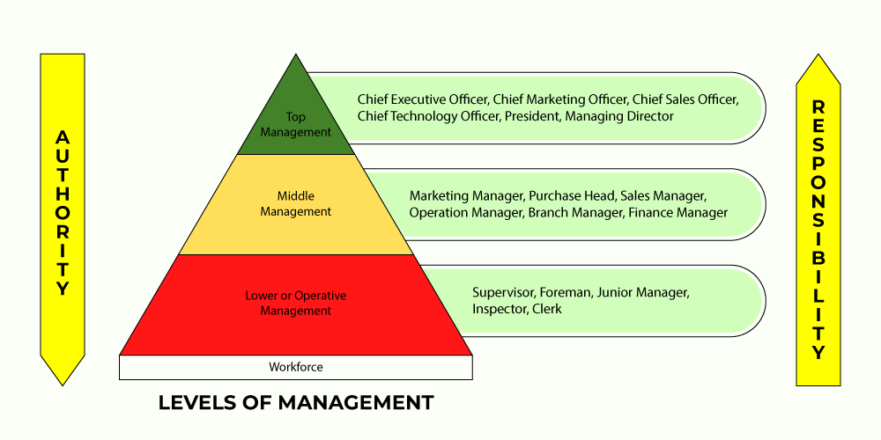
Levels of management

Slide 17
How many employees can a manager efficiently and effectively supervise?
Notes:
How many employees can a manager efficiently and effectively supervise? This question of span of control received a great deal of attention from early management writers. Although early writers came to no consensus on a specific number, most favored small spans—typically no more than six-seven workers—in order to maintain close control.

Slide 18
What is span of control?
Span of control
The span of control is the number of subordinates that can be effectively managed.
The larger the number of relationships between subordinates and the manager, the wider the span of control.
A narrow span of control is usually associated with a higher level of supervision, control, and coordination.
A wide span of control is usually associated with a higher level of autonomy, independence, and empowerment.
Notes:
Span of control is a principle of organizing that refers to the number of subordinates that can be effectively managed by a single manager. The span of control is determined by the number of individuals that a manager can effectively communicate with, coordinate, and supervise.
In general, a narrow span of control involves a smaller number of subordinates per manager, while a wide span of control involves a larger number of subordinates per manager. The choice of span of control depends on several factors, including the nature of the work, the complexity of the organization, and the experience and skill level of the manager.
A narrow span of control is typically associated with greater levels of supervision, control, and coordination. Managers with a narrow span of control are able to provide more individual attention and support to their subordinates, but may be limited in their ability to manage a large number of subordinates effectively.
A wide span of control, on the other hand, is typically associated with greater levels of autonomy, independence, and empowerment. Managers with a wide span of control are able to manage a larger number of subordinates more effectively, but may have less individual attention and support to provide to each subordinate.
Overall, the span of control is an important principle of organizing that helps to determine the appropriate level of supervision, control, and coordination within an organization. By choosing an appropriate span of control, managers can create an organizational structure that is well-suited to the needs and goals of the organization.

Slide 19
What is the difference between centralization and decentralization?
Who makes decisions in an organization?
Centralization
The concentration of decision-making power at the highest level of management.
If decision-making power is concentrated in one point or one person, then the organizational structure is centralized.
Decentralization
The transfer of decision-making to lower levels of management.
When decision-making power is distributed among departments, divisions, or teams, the organizational structure is decentralized.
Notes:
Centralization and decentralization are two contrasting principles of organizing that describe the distribution of decision-making authority and control within an organization.
Centralization refers to a structure where decision-making is concentrated at the top levels of an organization, typically in the hands of senior management or a small group of executives. In a centralized organization, decisions are made by a select few individuals who have access to information and resources necessary to make decisions for the entire organization. This often results in a hierarchical organizational structure, where information flows from top to bottom and decisions are implemented at the lower levels of the organization.
Decentralization, on the other hand, refers to a structure where decision-making authority is distributed among lower-level managers and employees. In a decentralized organization, individuals and teams have more autonomy and are empowered to make decisions based on their expertise and knowledge of the local context. This can lead to a more flexible and agile organizational structure, where decisions are made more quickly and effectively, and where employees are more engaged and motivated.
Both centralization and decentralization have their own advantages and disadvantages. Centralization can provide greater control and consistency, and can be useful in highly regulated industries or environments where standardization and compliance are important. Decentralization can foster greater innovation and creativity, and can be useful in dynamic and rapidly changing environments where the ability to adapt quickly is crucial.
In practice, many organizations adopt a hybrid approach, where decision-making is centralized in some areas of the organization and decentralized in others, depending on the needs and goals of the organization. By understanding the benefits and drawbacks of centralization and decentralization, managers can create an organizational structure that is well-suited to the needs and goals of the organization.

Slide 20
What is formalization?
Formalization
is an organizational principle that indicates the extent to which an organization's policies, procedures, rules, and job descriptions are standardized and documented.
The level of formalization can range from low, where few rules and procedures are documented, to high, where many rules and procedures are standardized and documented.
Formal organizational structure
refers to the official, document-based structure of an organization, including its power hierarchy, communication lines, and job responsibilities.
The formal structure is typically depicted in an organizational chart that outlines the roles of different positions within the organization and their reporting relationships.
Informal organizational structure
refers to the network of relationships, communication channels, and informal practices that exist within an organization, often outside of the official hierarchy and formal structure.
Notes:
Formalization is an organizing principle that specifies the extent to which an organization's policies, procedures, rules, and job descriptions are standardized and documented. Formalization can be evaluated on a scale from low formalization, where few rules and procedures are documented, to high formalization, where many rules and procedures are standardized and documented.
Formal organizational structure refers to the official, document-based structure of an organization, including its power hierarchy, communication lines, and job responsibilities. The formal structure is usually represented by an organizational chart that shows the roles of different positions in the organization and the reporting relationships.
Formal organizational structure provides employees with clarity and direction, helping them understand their roles and responsibilities in the organization. It also helps establish communication and decision-making lines that ensure an efficient flow of information throughout the organization.
Although formal organizational structure is important, it is not the only structure that exists within an organization. Informal structures, such as social networks and informal communication channels, can also have a significant impact on organizational performance. Informal structure refers to the network of relationships, communication channels, and informal practices that exist within an organization, often beyond the official hierarchy and formal structure. These informal structures can arise spontaneously among employees who work together based on common interests, social ties, or personal hobbies.
Formalization can have several advantages for an organization, including:
Increased efficiency: formalization can help standardize work processes, make them more efficient, and reduce the time and resources required to complete tasks.
Better coordination: formalization can facilitate the work of different parts of the organization working together because everyone is working according to the same rules and procedures. Increased control: formalization can help managers monitor and control employee actions because everyone is working according to the same rules and procedures.
Improved quality: formalization can help ensure that work is performed consistently and meets quality requirements because everyone is following the same rules and procedures.
However, formalization can also have some drawbacks, including:
Reduced flexibility: formalization can make it difficult to adapt to changing circumstances or take advantage of new opportunities.
Less innovation: formalization can stifle creativity and innovation because employees are expected to strictly adhere to rules and procedures.
Reduced job satisfaction: formalization can lead to employee boredom and dissatisfaction because the work becomes routine and repetitive.

Slide 21
What determines the choice of organizational principles?
Nature of the organization
For example, a large, complex organization may require a more formal structure with a narrow span of control, while a smaller, more flexible organization may be better suited to a decentralized structure with a wider span of control.
Goals and objectives
For example, an organization that values innovation and creativity may prioritize horizontal specialization and decentralization to encourage collaboration and flexibility, while an organization that values consistency and control may prioritize vertical specialization and centralization to maintain standardization and compliance.
External environment
For example, an organization operating in a highly regulated industry may prioritize formalization and centralization to ensure adherence to rules, while an organization operating in a dynamic, rapidly changing industry may prioritize flexibility and decentralization to adapt to changing circumstances.
Priorities and values
For example, a leader who values employee empowerment and autonomy may prioritize decentralization, while a leader who values control and consistency may prioritize centralization.
Notes:
The choice of organizing principles is influenced by a range of factors, including the nature of the organization, its goals and objectives, the external environment in which it operates, and the preferences and values of its leaders and employees. Some of the key factors that may influence the choice of organizing principles include:
Nature of the organization: The size, structure, and complexity of the organization may influence the choice of organizing principles. For example, a large, complex organization may require a more formal structure with a narrow span of control, while a smaller, more flexible organization may be better suited to a decentralized structure with a wider span of control.
Goals and objectives: The goals and objectives of the organization may also influence the choice of organizing principles. For example, an organization that values innovation and creativity may prioritize horizontal specialization and decentralization to encourage collaboration and flexibility, while an organization that values consistency and control may prioritize vertical specialization and centralization to maintain standardization and compliance.
External environment: The external environment in which the organization operates may also influence the choice of organizing principles. For example, an organization operating in a highly regulated industry may prioritize formalization and centralization to ensure compliance with regulations, while an organization operating in a dynamic, fast-changing industry may prioritize flexibility and decentralization to adapt to changing circumstances.
Preferences and values: The preferences and values of leaders and employees within the organization may also influence the choice of organizing principles. For example, a leader who values empowerment and autonomy may prioritize decentralization, while a leader who values control and consistency may prioritize centralization.
Overall, the choice of organizing principles is a complex decision that requires careful consideration of a range of factors. By understanding the nature of the organization, its goals and objectives, the external environment, and the preferences and values of its leaders and employees, managers can make informed decisions about how to organize work within the organization.

Slide 22
Mechanistic and organic organization
Mechanistic organization
A bureaucratic organization that represents a traditional "top-down" approach. The structure is characterized by high specialization, formalization, and centralization, a narrow management scope, strict departmentalization, and a clear chain of command.
There are many formal rules and procedures, centralized decision-making, narrowly defined responsibilities, and a strict hierarchical structure.
Organic organization
An organization that promotes collaboration and a more flexible approach. The structure is characterized by low specialization, informality, decentralization, a loose division of units, and a chain of command, whether long or short, which can sometimes be difficult to interpret.
There is moderate use of formal rules and procedures, decentralization and employee involvement in decision-making, widely defined responsibilities for tasks, structural flexibility, and a small number of hierarchical levels.
Notes:
A mechanistic organization (or bureaucracy) is an organization characterized by a high degree of formalization, standardization, and centralization. In a mechanistic organization, decision-making is centralized at the highest levels of the organization, and tasks and responsibilities are highly specialized and standardized.
Some key features of mechanistic organizations include:
Formal rules and procedures: Mechanistic organizations rely heavily on formal rules and procedures to control employee behavior and ensure that tasks are performed consistently and in accordance with rules and standards.
Hierarchical structure: Mechanistic organizations typically have a hierarchical structure with clear lines of authority and clearly defined reporting relationships.
Specialization: Mechanistic organizations typically have a high degree of specialization, with tasks and responsibilities assigned based on employee skills and competencies.
Centralization: Mechanistic organizations are typically highly centralized, with decision-making authority concentrated at the highest levels of the organization.
Focus on efficiency: Mechanistic organizations often seek to maximize efficiency and productivity, and may use various performance metrics to monitor and evaluate employee performance.
While mechanistic organizations can be effective in certain contexts, they may also have certain drawbacks. For example, emphasizing formal rules and procedures can make it difficult to adapt to changing circumstances or take advantage of new opportunities. The hierarchical structure and centralized decision-making can also stifle creativity and innovation, leading to low employee engagement and motivation.
An organic organization is an organization characterized by a low degree of formalization, decentralized decision-making, and a focus on collaboration and teamwork. In an organic organization, employees have a high degree of autonomy and the right to make decisions based on their experience and knowledge.
Some key features of organic organizations include:
Flexible structure: Organic organizations typically have a flexible structure that can quickly adapt to changing circumstances and new opportunities.
Decentralized decision-making: Organic organizations rely on decentralized decision-making, distributing authority and responsibility to employees and teams.
Multifunctional teams: Organic organizations often use multifunctional teams to solve problems and perform tasks, encouraging collaboration and teamwork.
Focus on innovation and creativity: Organic organizations prioritize innovation and creativity and may encourage experimentation and risk-taking to find new solutions to problems.
Informal communication channels: Organic organizations typically have informal communication channels, such as social networks and unofficial meetings, that allow employees to freely share information and ideas.
While organic organizations can be effective in certain situations, they may also have certain drawbacks. For example, emphasizing decentralization and autonomy can make it difficult to maintain consistency and standardization across different parts of the organization. The focus on innovation and creativity may also be unacceptable in highly regulated industries or environments where compliance is critical.

Slide 23
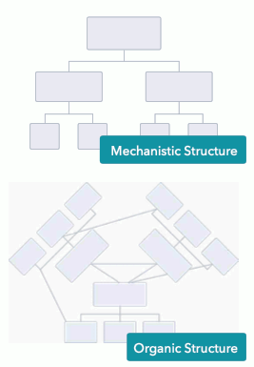
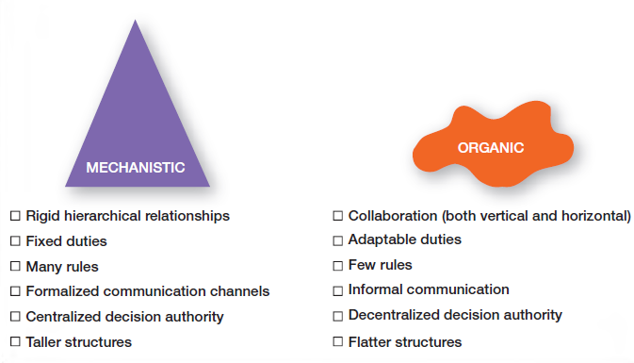

Slide 24
Organizational structure

Slide 25
What is organizational structure?
Structure
The arrangement of parts or elements and the relationships between them as a whole.
Organization
A group of individuals who work together towards a common goal.
Organizational management structure
Defines and regulates the relationships between different positions and roles within an organization, giving the organization a certain form. It is necessary to coordinate the activities of the organization, delegate authority, and ensure control over its operations.
Notes:
Organizational structure refers to the way in which an organization is designed or arranged. To understand this concept, it is useful to first consider the meanings of the individual words that make it up.
Structure refers to the way in which something is organized or arranged. This includes the relationships between different parts of a whole, as well as the rules and procedures that regulate those relationships. In the context of an organization, structure refers to the formal relationships between different roles and positions within the organization, as well as the flow of information, power, and decision-making.
On the other hand, organization refers to a group of people working together towards a common goal. Organizations can take many forms, from small businesses to international corporations, and from non-profit organizations to government agencies.
In summary, the term "organizational structure" refers to the way in which an organization is structured or arranged to achieve its goals and objectives. This includes the formal relationships between different roles and positions within the organization, as well as the rules and procedures that regulate those relationships.
An organization's organizational structure can take many forms depending on factors such as the organization's size, complexity, goals, and external environment. Some common types of organizational structures include functional, divisional, matrix, flat, and hierarchical structures.
The choice of organizational structure can have a significant impact on an organization's ability to achieve its goals and objectives. Therefore, it is important for leaders to understand the advantages and disadvantages of various types of organizational structures in order to design the best organizational structure for their organization.

Slide 26
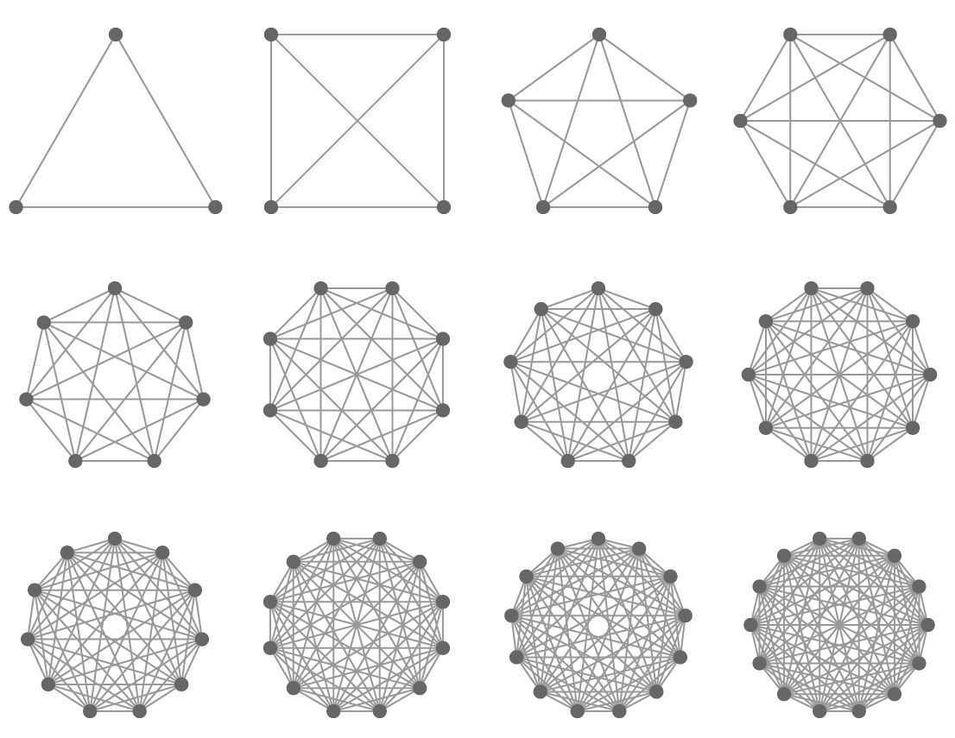
What is the purpose of organizational structure?
As the number of elements increases, the number of connections between them increases progressively.
Thus, the complexity of a system increases.
To manage complexity, structure must be introduced.

Slide 27
What is organizational hierarchy?
Hierarchy
is the arrangement of elements into levels or ranks based on their importance, depicted as "above," "below," or "at the same level" with each other.
Organizational hierarchy
refers to the importance of positions held by members of an organization based on their level of authority. It establishes a system of authority and control within the organization through the creation of a certain number of management levels. (See slide "Chain of Command," "Management Levels.")
A certain degree of hierarchy exists in every organizational structure!
Notes:
Organizational hierarchy refers to the levels of authority and decision-making within an organization. It involves the formal structure of the organization, including the positions, roles, and responsibilities of employees at different levels of the hierarchy.
Organizational hierarchy typically includes multiple levels of management, with each level responsible for different functions and decision-making. The highest level of the hierarchy is typically the executive level, which includes top-level managers such as CEOs and presidents. The middle level of the hierarchy includes managers and supervisors who are responsible for overseeing the work of employees at the lower levels of the organization. The lowest level of the hierarchy includes front-line employees who are responsible for performing the day-to-day tasks required to achieve the organization's goals.
While not all organizational structures rely on a strict hierarchical system of authority and decision-making, it is true that a certain degree of hierarchy is present in every organizational structure. Even in flatter or more decentralized structures, there will typically be some form of reporting relationships, lines of authority, or decision-making processes that create a degree of hierarchy within the organization.
The level of hierarchy and the degree of centralization vs. decentralization within an organizational structure will depend on a variety of factors, such as the size and complexity of the organization, the nature of its goals and objectives, and the external environment in which it operates. Ultimately, the choice of organizational structure will depend on the specific needs and circumstances of the organization, and managers must carefully consider the advantages and disadvantages of different structures when designing their organization.

Slide 28
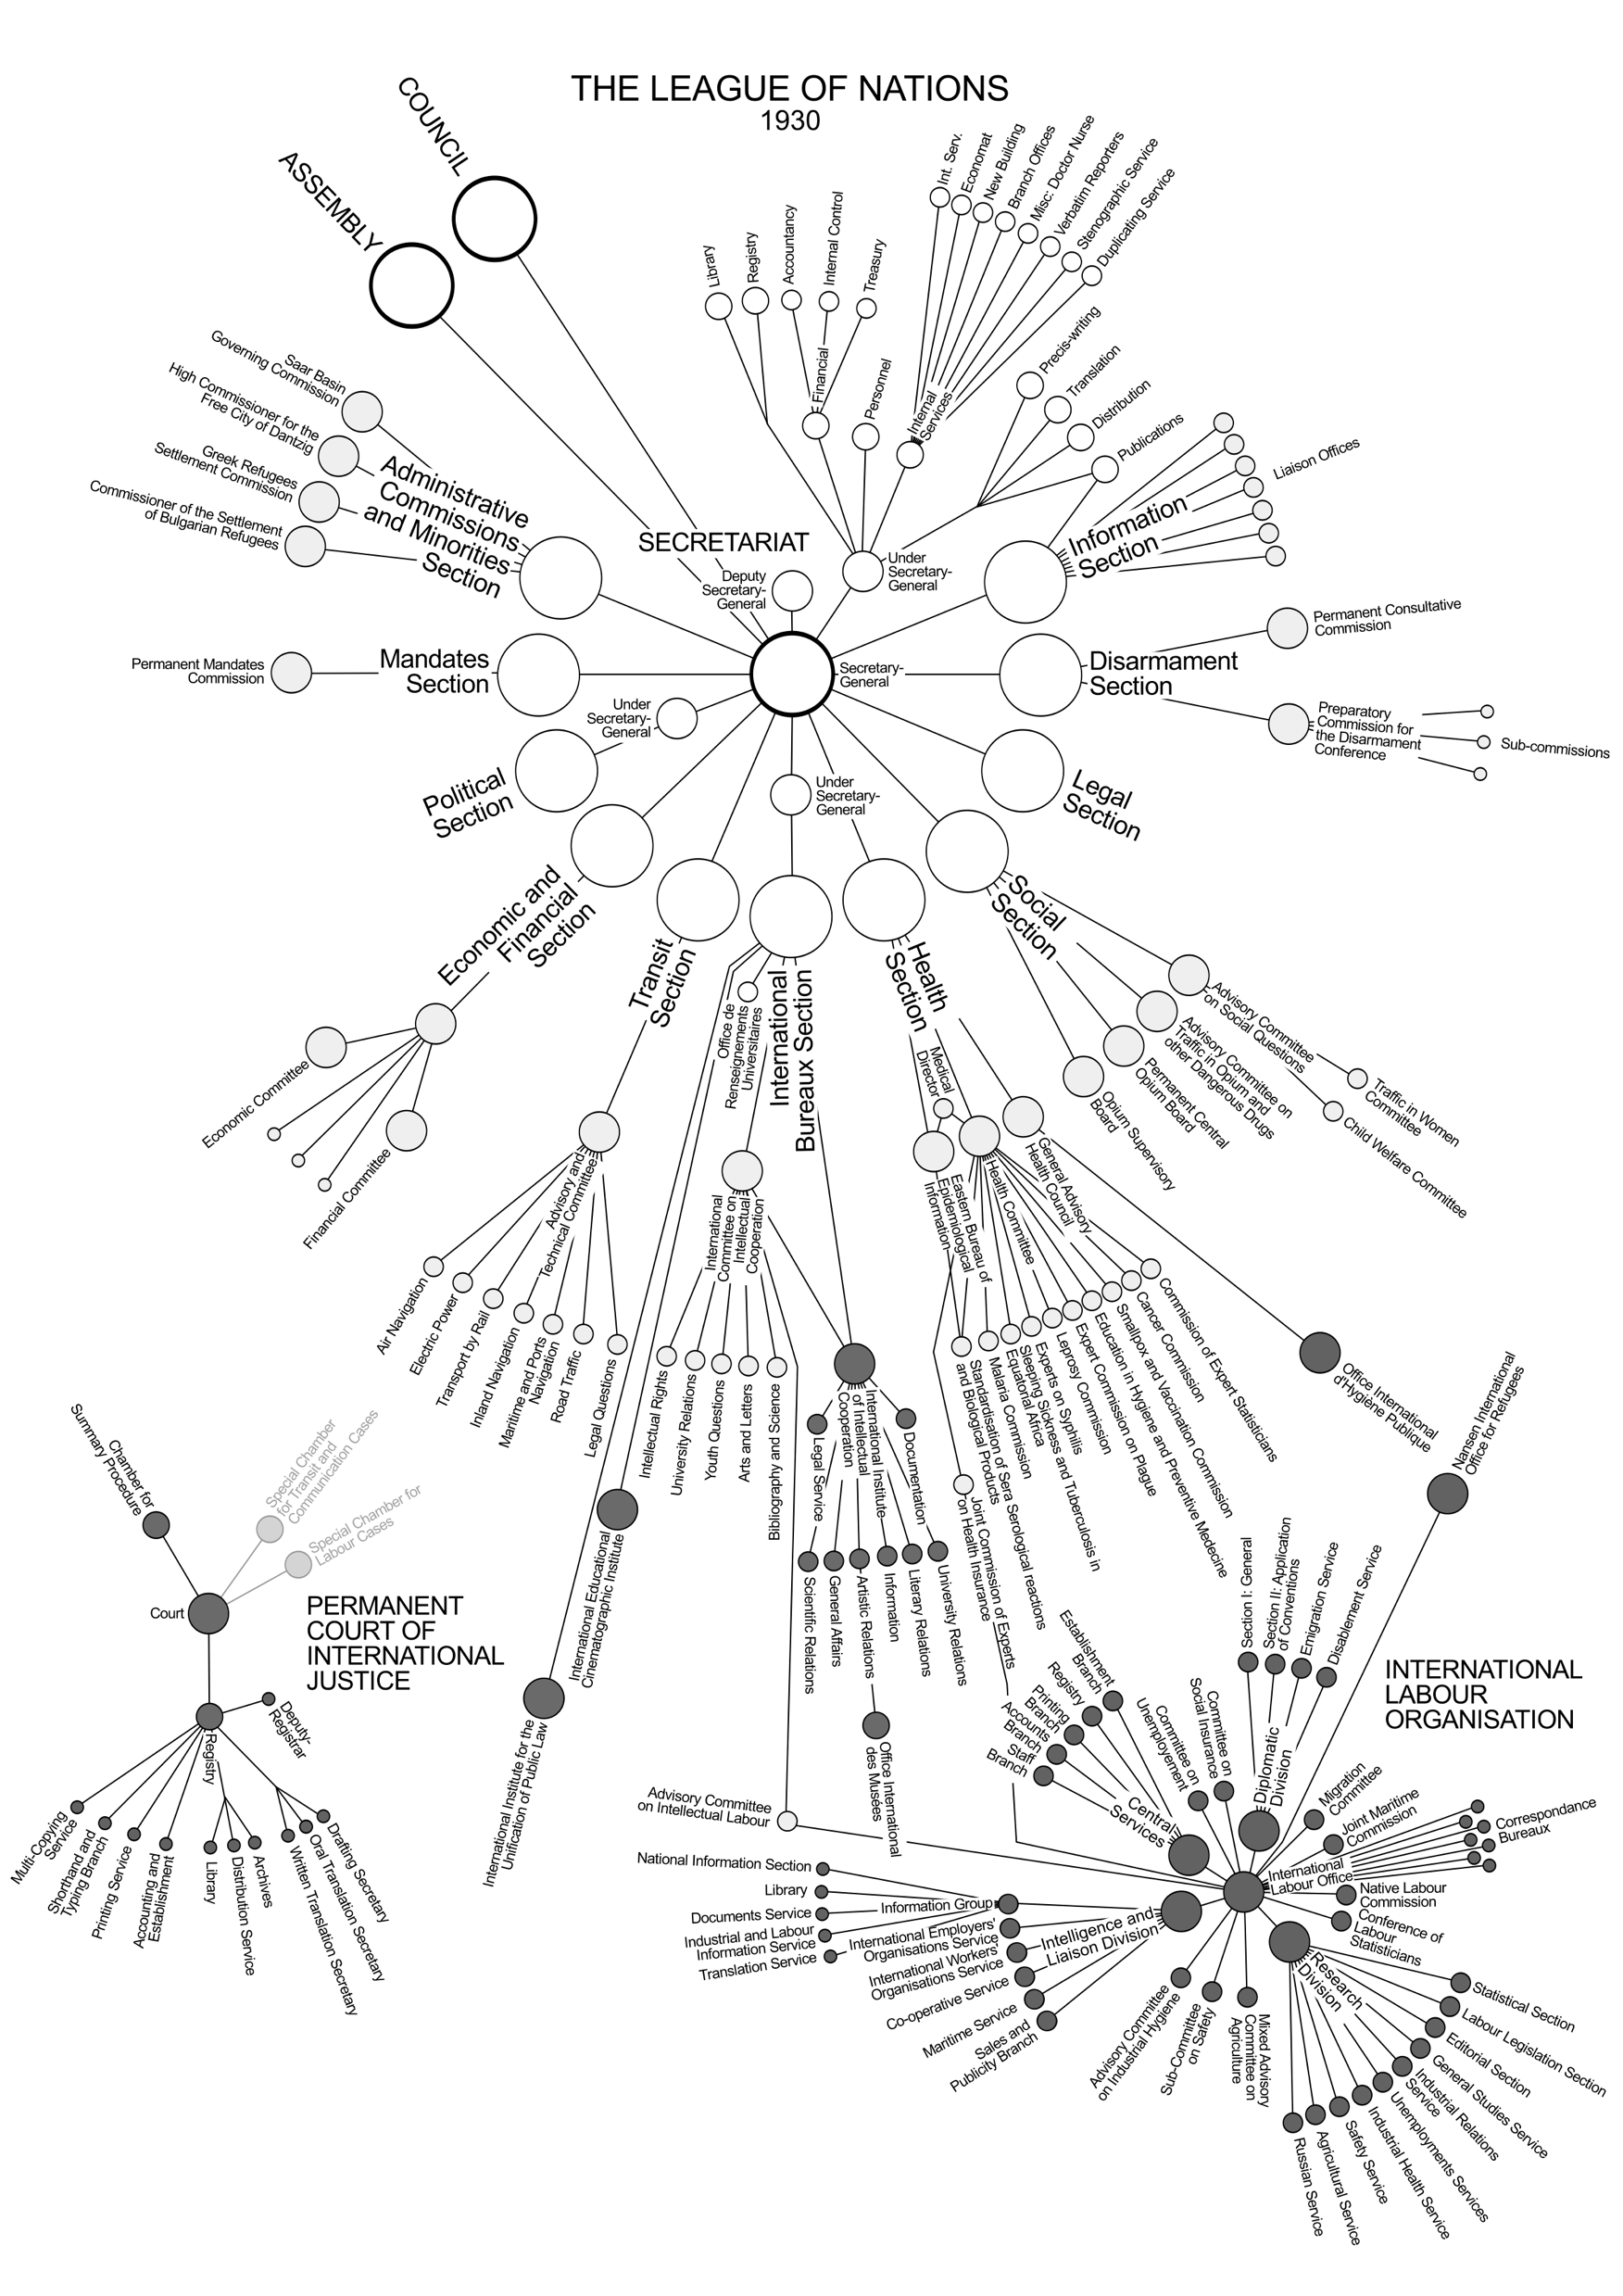

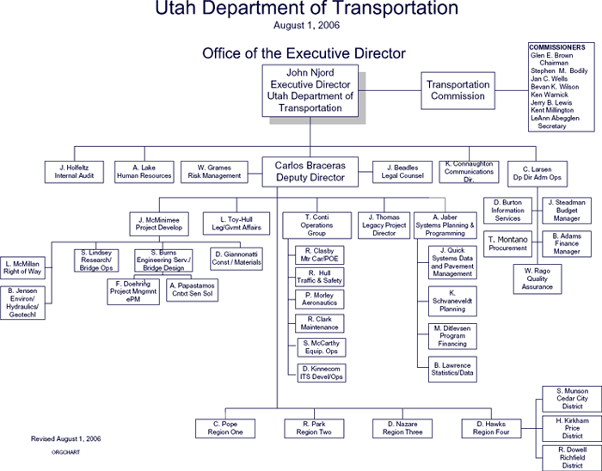
Graphic representation of organizational structure: Organizational Chart, Organogram
Notes:
The graphic representation of organizational structure is a visual depiction of how an organization is designed and structured. Various visual tools are commonly used to illustrate positions, roles, and relationships within an organization.
An organizational chart (or organigram) is one type of graphic representation of organizational structure. It is a visual method of designing and laying out an organization, typically using boxes or other shapes to represent different positions within the organization, and lines to show their relationships and reporting lines.
Organigrams can be useful in understanding the overall structure of an organization, including its hierarchy of positions and reporting relationships, and can also be useful in communicating this information to others. However, it's important to note that an organigram is just one type of graphic representation of organizational structure, and may not fully convey the complexity of the organizational structure.

Slide 29
The diversity of organizational structure types
Functional structure
Divisional structure
Matrix structure
Flat structure
Hierarchical structure
Network structure
Simple structure
Team-based structure
Project-based structure
Hybrid structure
Circular structure
Holacracy structure
Virtual structure
Lateral structure
Cooperative structure
Adaptive structure
Franchise structure
Cross-functional structure
Agile structure
Customer-focused structure
Notes:
There are many different types of organizational structures. Each of these types has its own unique advantages and disadvantages, and the choice of structure will depend on the specific needs and goals of the organization. Some structures, such as functional and divisional structures, are more traditional and common, while others, such as holacracy and agile structures, are newer, reflecting a changing approach to work.

Slide 30
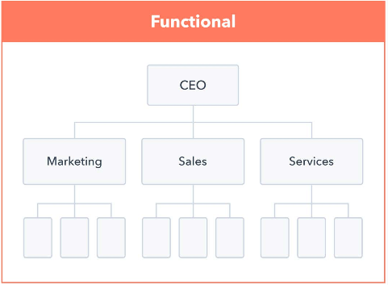
Functional structure
Employees are grouped according to similar functions or areas of competence, such as finance, marketing, operations, and so on.
In a functional structure, each functional area is typically led by a manager or director who oversees the work of employees in that area.
Notes:
In a functional structure, employees are grouped according to similar functions or areas of expertise, such as finance, marketing, or operations. This structure can promote efficiency and specialization, as employees can focus on their specific areas of expertise and improve their specialized skills and knowledge.
In a functional structure, each functional area is typically led by a manager or director who oversees the work of employees in that area. This manager is responsible for setting goals and objectives for their area of responsibility, as well as coordinating and communicating with other functional areas to ensure that overall organizational goals are achieved.
One of the main advantages of a functional structure is that it can help promote cost and effort reduction, as similar functions are consolidated into one department. It can also help promote consistency and standardization in organizational activities.
However, a functional structure can also have certain drawbacks. Coordinating various functional areas can be complex, leading to silos where employees focus more on their individual functions rather than overall organizational goals. Additionally, decision-making can be slow and bureaucratic, as decisions in each functional area need to be passed up and down the hierarchy.

Slide 31
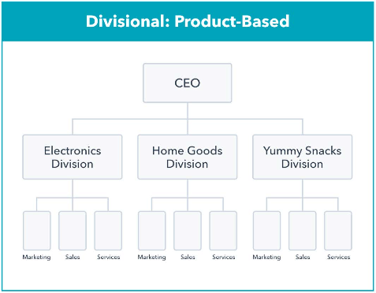
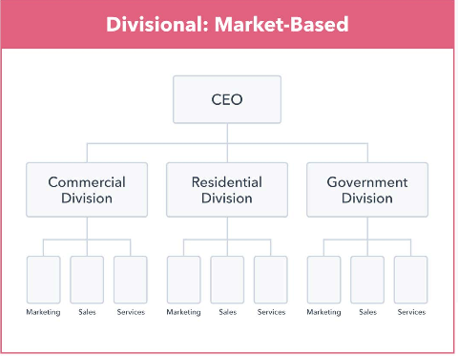
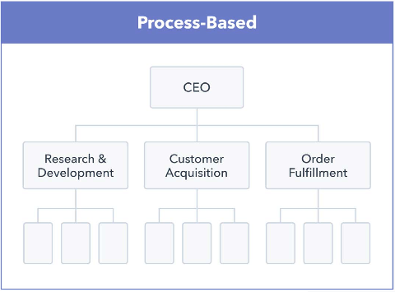
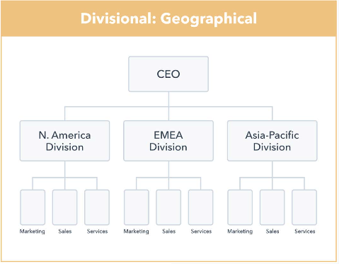
Divisional structure
The organization is divided into semi-autonomous units based on factors such as geography, product lines, processes, or customer groups.
Each unit has its own functional areas such as marketing, finance, and operations, and operates as a fairly independent unit within the larger organization.
Notes:
In the divisional structure, an organization is divided into semi-autonomous units based on factors such as geography, product lines, or customer groups. Each unit has its functional areas, such as marketing, finance, and operations, and operates as a relatively independent entity within the larger organization.
In the divisional structure, each unit is typically led by a director who is responsible for the overall performance of the unit. The general manager has significant decision-making authority and is responsible for setting goals and objectives for the unit, as well as coordination and communication with other units.
One of the main advantages of the divisional structure is that it can promote flexibility and adaptability, as each unit can quickly respond to changes in a particular market or environment. Additionally, units can be structured to maximize efficiency and effectiveness in specific areas of operation, which can help improve overall organizational performance.
However, the divisional structure can also have some drawbacks. Communication and coordination between units can be complex, and there may be duplication of effort in areas where unit activities overlap. Additionally, decision-making may be decentralized, which can lead to inconsistencies in strategy and direction across different units.

Slide 32
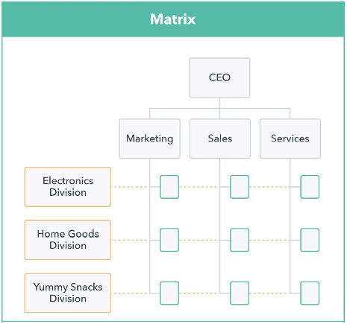
Matrix structure
Matrix structure combines the features of functional and divisional structures.
In a matrix structure, each employee usually has two bosses: a functional manager who supervises their work in a specific functional area, and a project manager who supervises their work on a specific project or product.
Notes:
Matric structure is a type of organizational structure that combines the features of functional and divisional structures. In a matrix structure, employees are grouped into functional departments such as marketing or engineering, as well as into product or project teams that encompass various functional areas.
In a matrix structure, each employee typically has two bosses: a functional manager who oversees their work in a specific functional area, and a project manager who supervises their work on a particular project or product. This can help promote cross-functional collaboration, as employees can share information and resources across different functional areas and work more closely with colleagues from different departments.
One of the main advantages of a matrix structure is that it can promote flexibility and responsiveness, as employees can quickly adapt to changes in specific projects or markets. Additionally, this structure can promote innovation and creativity, as employees can draw on diverse experiences and perspectives from across the organization.
However, a matrix structure can also have some drawbacks. Communication and coordination between various divisions and project teams can be complex, and conflicts over resources and priorities may arise between functional and project managers. Additionally, decision-making can be difficult and slow, as employees may have to navigate multiple levels of authorization and approval.

Slide 33
Flat structure
Hierarchical structure
Less levels of hierarchy
Decentralized decision-making
Teams can be organized by projects, customers or products
Team leaders have decision-making authority
Promotes flexibility, adaptability, and employee empowerment
Many levels of hierarchy
Centralized decision-making
Clear chain of command
Each level has its duties and decision-making authority
Promotes stability, consistency, and standardization
Notes:
Flat structure is a type of organizational structure that has fewer levels of hierarchy and a more decentralized decision-making process. In a flat structure, there may be little or no hierarchy, and employees may have more autonomy and decision-making power.
In a flat structure, teams can be organized around specific projects, customer groups, or products, rather than traditional functional areas. Each team is typically led by a team leader or project manager, who is responsible for the overall performance of the team. These team leaders may have significant decision-making authority and may be empowered to make decisions and allocate resources within their team.
One of the main advantages of a flat structure is that it can promote flexibility and adaptability, as decision-making is decentralized and teams can quickly respond to changes in specific markets or environments. Additionally, this structure can promote employee empowerment and engagement, as employees are given more autonomy and decision-making authority.
However, flat structure can also have some drawbacks. Communication and coordination among teams can be challenging, and efforts can be duplicated in areas where teams overlap. Additionally, decision-making may be less consistent than in more hierarchical structures, which can lead to inefficiencies and inconsistency.
A hierarchical structure is a type of organizational structure characterized by multiple levels of authority and a clear chain of command. In a hierarchical structure, each employee typically reports to one or more supervisors, and decisions are made at the highest levels of authority.
In a hierarchical structure, decision-making and communication are typically centralized at the top, and lower-level employees have little autonomy or decision-making power. Each level of the hierarchy has its own set of responsibilities and decision-making authority, and employees are expected to follow the directives of their supervisors.
One of the main advantages of a hierarchical structure is that it can provide stability and clarity in decision-making, as there is a clear chain of command and a set of rules and procedures governing organizational behavior. Additionally, this structure can promote consistency and standardization in organizational operations.
However, a hierarchical structure can also have some drawbacks. Communication and coordination between different levels of the hierarchy can be challenging, and decision-making may be slow and bureaucratic. Additionally, this structure may not be suitable for organizations that value innovation, agility, and employee empowerment.

Slide 34
Key takeaway
An organization can have characteristics of multiple types of structures at the same time.
For example, an organization may have a functional structure in each department of the company, and also use a matrix structure to manage specific projects.
Organizational structure is constantly changing due to various external and internal factors.
For example, if a technology company acquires another company with a different organizational structure, it may need to restructure its organization to effectively integrate the new company.
If an organization grows, its management structure must change.
For example, a small startup may begin with a flat structure that allows for flexible and quick decision-making, but as the company grows and becomes more complex, it may transition to a more hierarchical structure to promote stability and consistency.
Notes:
Organizational structures are not mutually exclusive, so an organization can have characteristics of multiple types of structures at the same time. For example, an organization may have a functional structure in each department, as well as use a matrix structure to manage specific projects.
In addition, the type of organizational structure used by an organization may change over time as the organization grows, adapts to new challenges and opportunities, or responds to changing circumstances. For example, a small startup may begin with a flat structure that allows for flexibility and quick decision-making, but as the company grows and becomes more complex, it may transition to a more hierarchical structure to promote stability and consistency.

